Slide 1


Slide 2
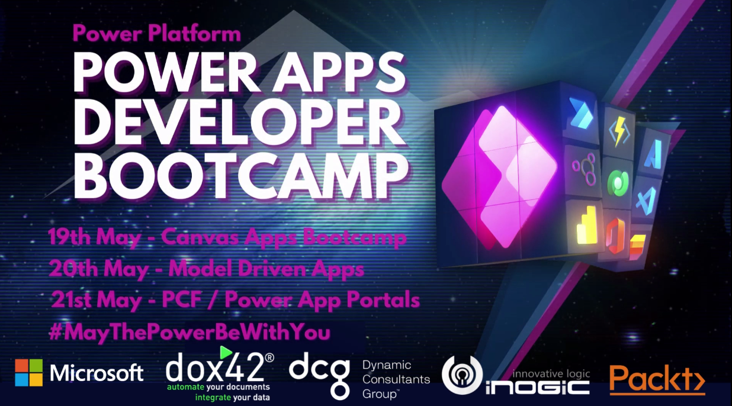

Slide 3


Contact details
Jordi Montaña
jordi@dynamicsvalue.com
https://www.linkedin.com/in/jordimontana/
@jordimontana
@FakeXrmEasy

Slide 4
Agenda
History / Stats
Why? / Research Study
Roadmap
What’s New
Unit Testing Azure Functions against Dataverse
Q & A
https://dynamicsvalue.com

Slide 5
History
2014
2015
2017
2020-2021
Nov 24: First version of FakeXrmEasy is published v1.x | Founded DynamicsValue company | Got MVP Awards: 2017 2018 Participated in many CRM Saturdays around the world | FakeXrmEasy v2.x
https://dynamicsvalue.com

Slide 6
Stats
7 years
1.5M+ Downloads
241+ GitHub Stars
160+ Forks
70+ Countries
https://dynamicsvalue.com

Slide 7
Stats
7 years
1.5M+ Downloads
241+ GitHub Stars
160+ Forks
70+ Countries
https://dynamicsvalue.com

Slide 8
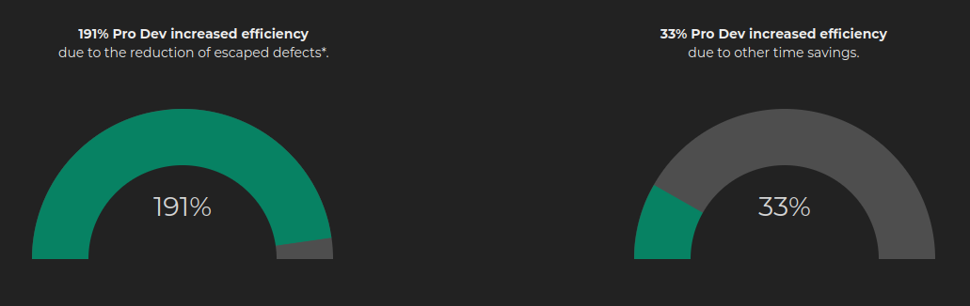
Why / Research Study
https://dynamicsvalue.com/white-paper
https://dynamicsvalue.com

Slide 9
Why?
Quantified Benefits include:
191% increased ProDev efficiency due to reduction of escaped defects*
33% increased ProDev efficiency due to other time savings*
* results will vary across organizations. Study will be published soon, please drop me an email if you want the PDF earlier: jordi@dynamicsvalue.com

Slide 10
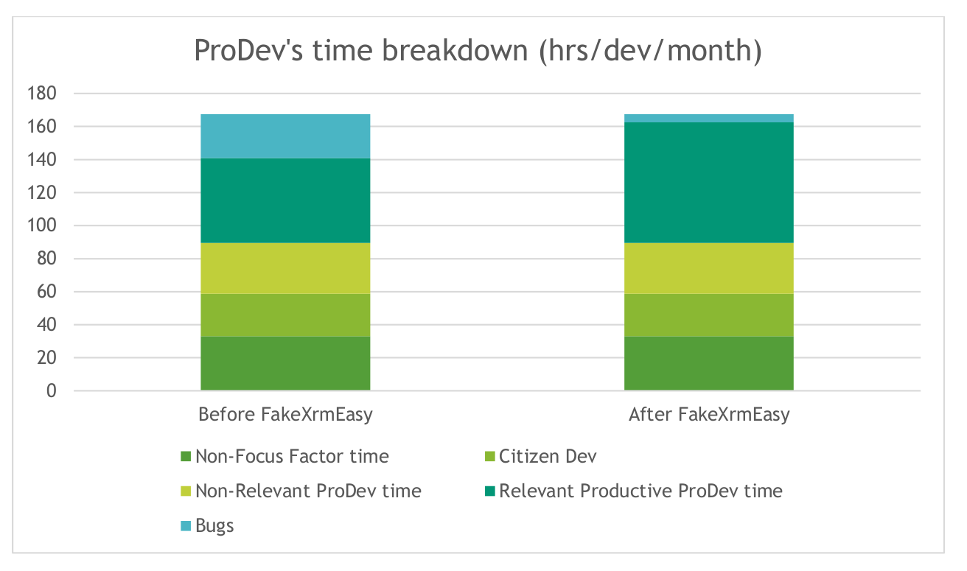
Why? / Research Study

Slide 11
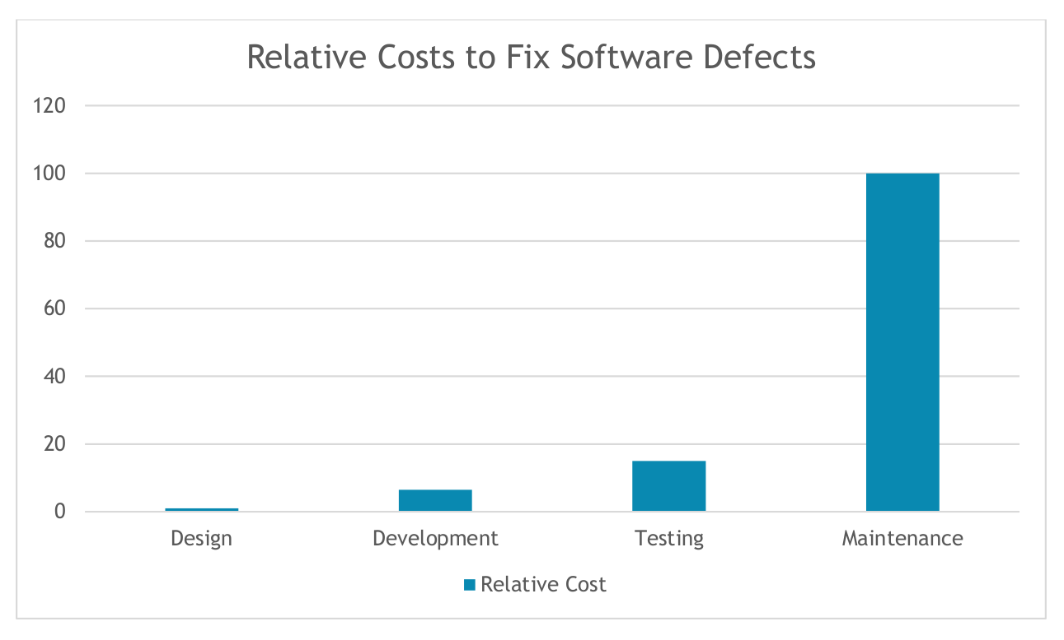
Why? / Research Study
Factor =
100 / 6.5 =
15x
Source: IBM Systems Sciences Institute study
https://www.isixsigma.com/industries/software-it/defect-prevention-reducing-costs-and-enhancing-quality/

Slide 12
Why?
Unquantified benefits (Testimonials):
“Now that I discovered this way of working,
I would NEVER go back to writing code without unit tests
and I am constantly encouraging others to adopt this best practice.”
- Ben, former senior analyst / developer at a highly respected UK University, and now senior developer at a CRM Consultancy.
“Helps us massively with code coverage,
and allows us to hit all of our KPIs alongside
the rest of our engineering practice”
- Lead Developer at a Central Bank
“Cuts dev time down significantly as can
test very easily. I find bugs almost instantly now rather than with other methods.”
- Principal Architect

Slide 13
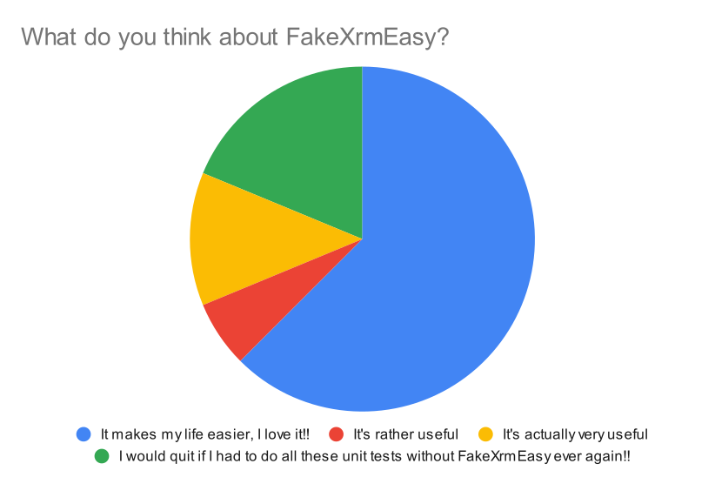
What do developers think about FakeXrmEasy?

Slide 14
Roadmap (2021 and beyond)
v1.x
v2.x
v3.x
.Plugins CodeActivities .Net Applications Full .NET Framework - In “Maintenance / Deprecated” mode | - Full .NET framework Depends on XrmTooling / CrmSdk.CoreAssemblies - Supports server side development, for which DataverseClient is not intended - Might also be ideal for On-Prem customers | - .net core only Package that depends on DataverseClient (in public preview) - Will support DataverseClient specific functionality (i.e. async)
DataverseClient: https://www.nuget.org/packages?q=microsoft.powerplatform.cds.client

Slide 15
Which one should I use… ?
Component / App Type | Recommended version
Plugins, Workflow CodeActivities, Azure Functions v1 runtime, or any other CrmServiceClient app Any client applications in .net core 3.1, including: Bespoke web portals, Azure Functions v3 runtime, and so on… *Azure Functions v4 runtime targets .net 6 however ServiceClient still has .netcore 3.1 as baseline | 2.x 3.x

Slide 16
What’s new in v2.x / v3.x
New middleware architecture almost identical between 2.x and 3.x
https://github.com/DynamicsValue/fake-xrm-easy
.net core support
Sonar Quality Gates
Refactoring / restructuring of packages:
FakeXrmEasy.Abstractions
FakeXrmEasy.Core
FakeXrmEasy.Messages.*
FakeXrmEasy.Plugins
FakeXrmEasy.CodeActivities (v2.x and windows only)
Powershell & GitHub Actions Build

Slide 17
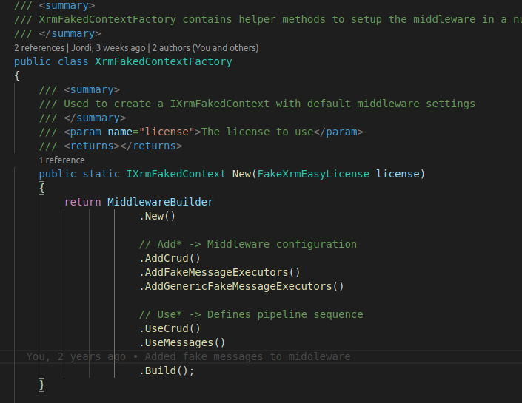
New Middleware
Previously in v1.x there was one message execution per OrganizationRequest
Now OrganizationRequests go through a configurable pipeline execution

Slide 18
Middleware
Middleware: Add** steps add properties to the IxrmFakedContext that are needed to then “Use” these steps
Use*** methods define the pipeline sequence

Slide 19
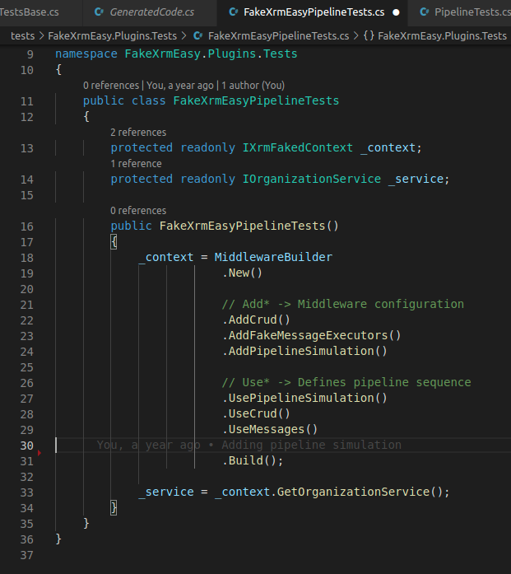
Middleware (II)
Pipeline Simulation example

Slide 20
Middleware Benefits
Decouples implementation : we can add other future packages without touching any of the existing ones (i.e. Security role validation)
Makes the behaviour of the framework explicit
Configurable: only setup what you need
Efficient: run tests for what’s needed at each package, saving build & test time

Slide 21
Unit Testing Azure Functions
Multiple authentication / authorization methods
Regardless, it’s a good idea to separate authentication logic from business logic
Make your business logic depend only on interfaces so that it can be unit tested
Other good tutorials about Azure Functions:
Phil Cole, Using Azure Functions in the Dataverse: https://www.youtube.com/watch?v=p7wG4lmfE90
Demian Raschkovan, Extendiendo Dataverse con Azure Functions: https://www.youtube.com/watch?v=cpecE0F7QE8&t=2036s

Slide 22
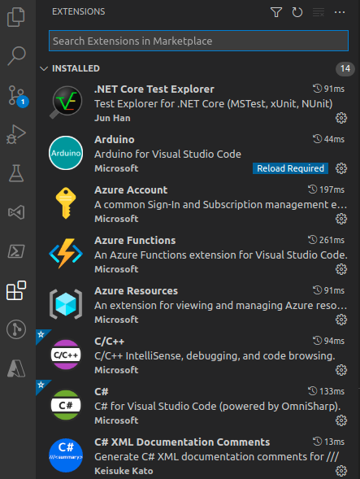
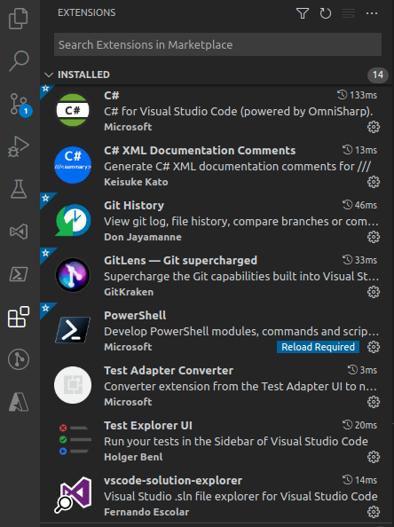
Azure Functions: VSCode extensions
Azure Functions
Solution Explorer
Test Explorer UI
.NET Core Test Explorer

Slide 23
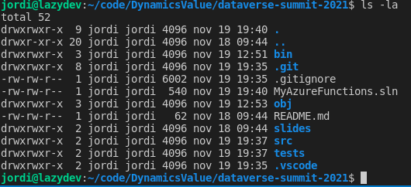

Folder Layout
This is a personal choice, but I like to structure projects using this folder structure:
|-- .sln
|-- src/
| – source projects here
|-- tests/
| – test projects here

Slide 24
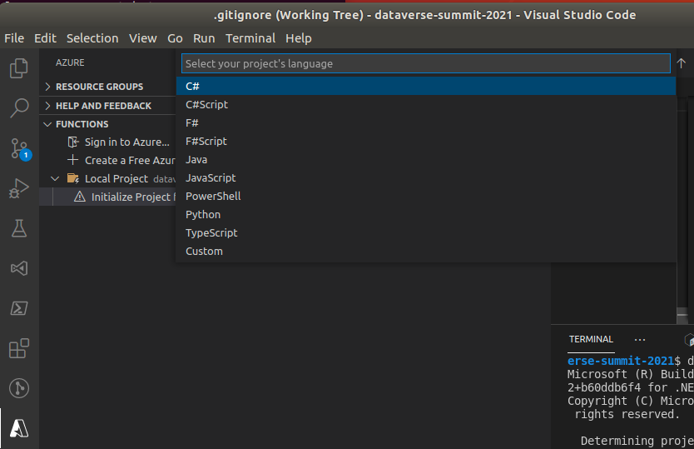
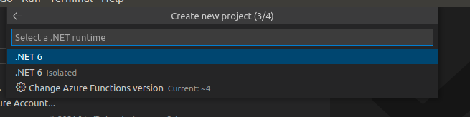
Create project
Create project and pick
C#
v3 runtime
Choose trigger
Trigger name and namespace
AccessRights

Slide 25
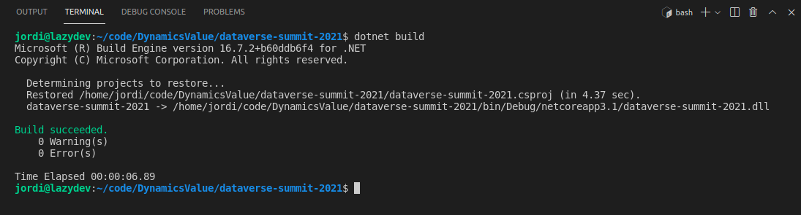
Build
Build the project so that it restores the necessary Azure Function nuget packages

Slide 26
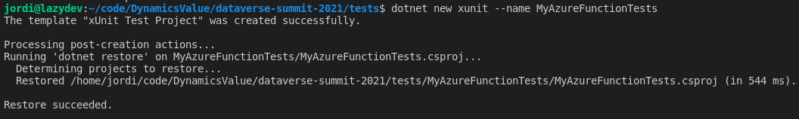
Create Unit Test Project

Slide 27
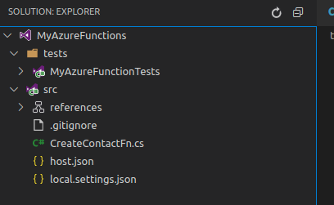
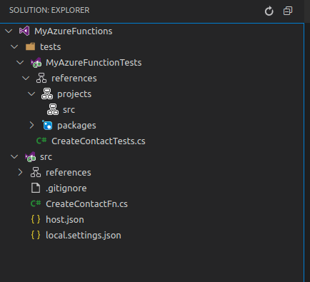
Add both projects to solution...
… via solution Explorer Extension
Clean way to see only relevant (C#) files
Also add src project as a project reference of the test project

Slide 28

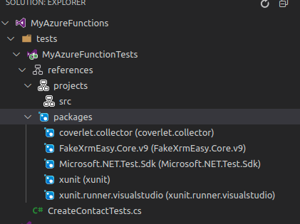
Install FakeXrmEasy
… via the command line
… or via adding the PackageReference and then restoring it

Slide 29
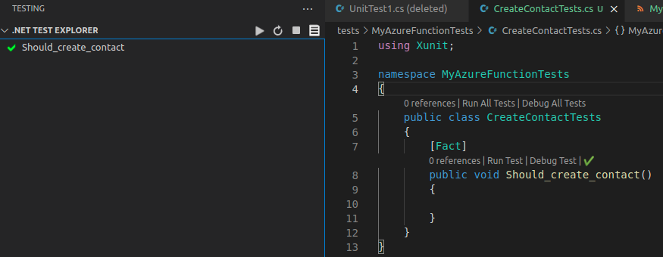
Use .NET Test Explorer
Once projects references have been added and FakeXrmEasy installed, we are in a position to start testing the Azure Function

Slide 30
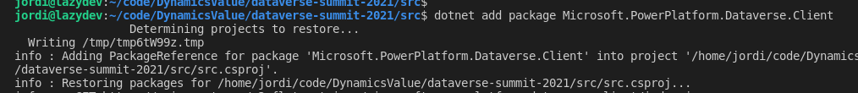
Add Dataverse.Client package

Slide 31
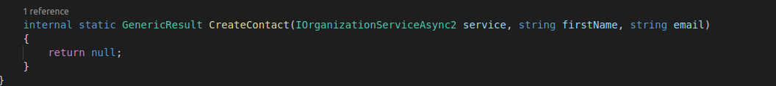
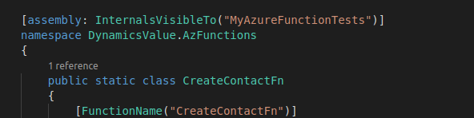
Add Dataverse.Client package
… and then … Add an empty internal method to the azure function class in charge of creating a contact

Slide 32
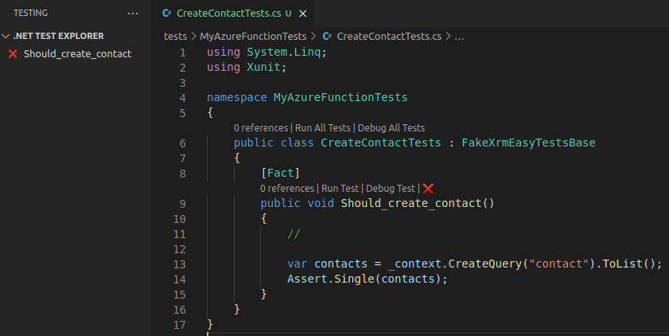
Add unit test
Make our test class inherit from the base class
We have now a failing unit test to start with

Slide 33
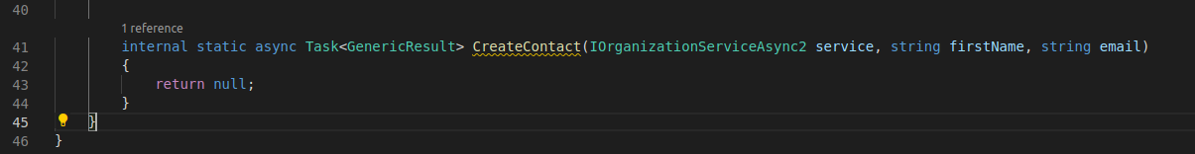
Add async
Testing async methods with xUnit is straightforward

Slide 34
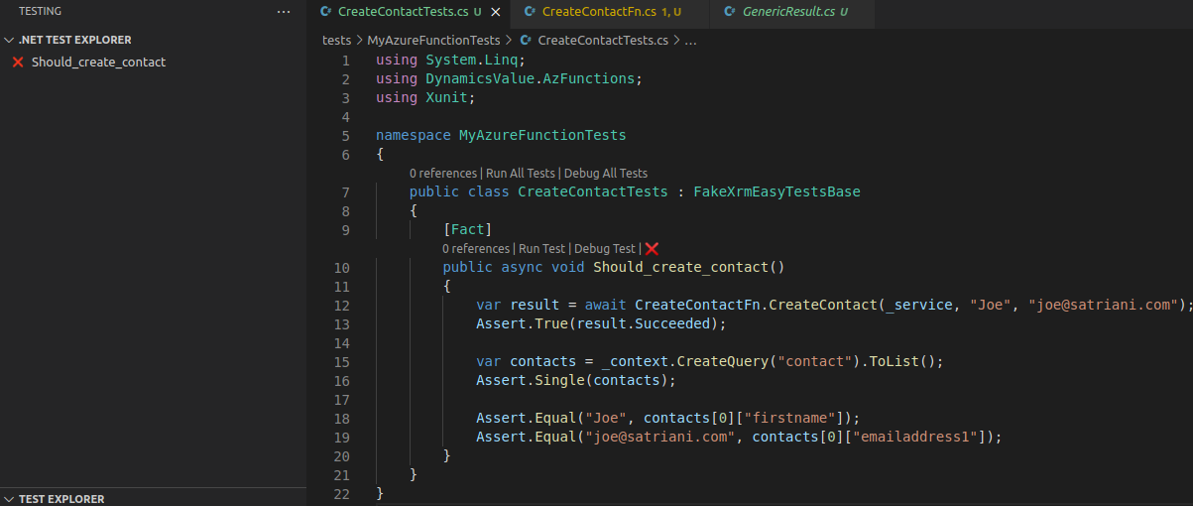
Add async (II)
Testing async methods with xUnit is straightforward

Slide 35
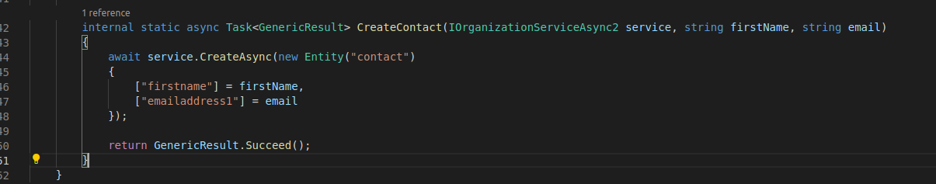
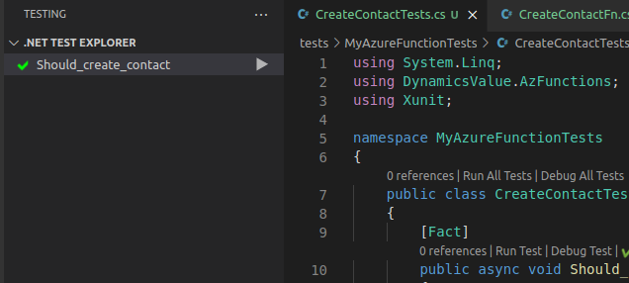
Implement actual logic….
… and voilà… :)

Slide 36
Recap
Unit Testing is a fundamental aspect of the ALM story
ProDev increased efficiency
Develop & debug locally many, without hitting an actual Dataverse environment
v1.x is deprecated and in maintenance mode
Use v2.x for server-side development on Windows
Use v3.x for client-side dev in .net core 3.1
The slides of this demo as well as the code samples, can be found here:
https://github.com/DynamicsValue/dataverse-summit-2021

Slide 37
Thanks for your time …
¿any questions?

Slide 38
Main Title
Section

Slide 39
Header
Text 1
Text 2
Text 3

